Slide 1
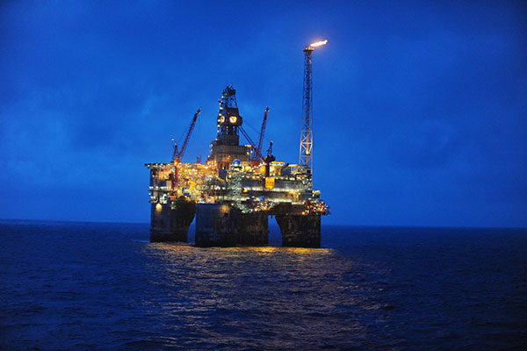
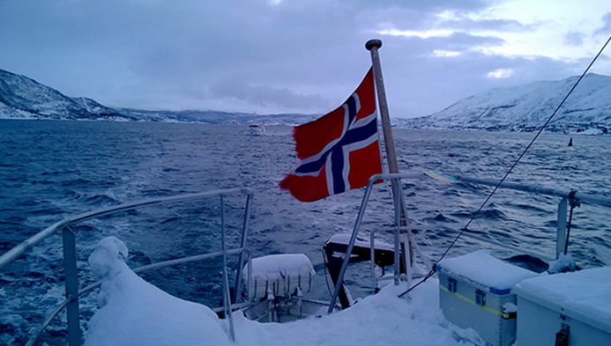
Norway – Unknown Giant Neighbour
Jukka Suokas
Commercial Counsellor / Senior Advisor
Business Finland / Finnvera
Oslo Norway
Turusta ohituskaista maailmalle, Turku 19.11.2018
Business Finlandin palvelut tutuiksi
Photo: ML
Source: Offshore Technology

Slide 2
Finland Norway
Size 338,145 sq km
Population 5,50 mill
State budget € 55,8 bill (2018)
Exports € 59,7 bill (2017)
Imports € 64,4 bill (2017)
GNP € 252 bill (2017)
Unemployment 8,6 % (2017)
Export to Norway € 1,6 bill (2017), 13.
Size 323,802 sq km
Population 5,23 mill
State budget € 143 bill (2018 )
Exports € 115 bill (2017)
Imports € 115 bill (2017)
GNP € 348 bill (2017)
Unemployment 3,8 % (2017)
Export to Finland € 1,5 bill (2017)

Slide 3
Norway is Rich
Norway Oil Fund (GPFG) $1000 bill (1st inv. fund)
7,8 % profits 2017, investments > O&G tax/licensing
Max. 3 % of profits can be used in state budget
2019 State budget $164 bill (2,7 % from GPFG)
Source: www.nbim.no

Slide 4
It’s All About Oil and Gas
Ekofisk discovery in 1969, production started 1971
Drop in oil price 2014 improved redundancies and cost efficiency
Production break even dropped from $ 80 to $ 35 per barrel
Oil investments 2017 were € 15 bill – mostly replacements
In other words, Equinor buys subcontracting worth € 15 bill/a !!!
Dec. 2017 Johan Castberg field € 5 bill new investment (Equinor, Eni, Petoro)
Published deals: Aker Solutions, ABB, Kværner, Sembcorp Marine Rigs & Floaters, Alcatel Submarine Networks
Photo: Offshore technology

Slide 5
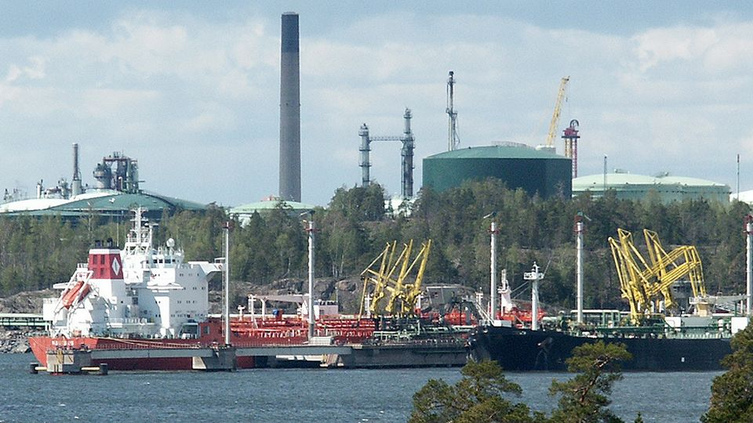
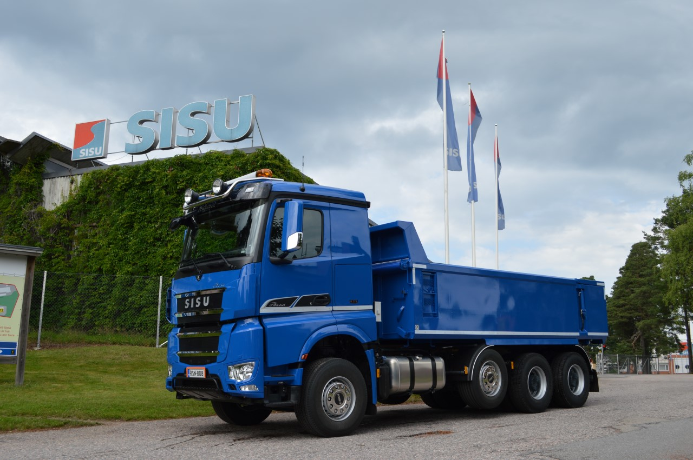
Import from Norway Export to Norway
Oil
Salmon and seafood
Aluminium
Trucks, vans and special vehicles
Refined oil products
Furtilizers

Slide 6
Oil won’t disappear very soon, but…
Biggest oil producers: USA, Russia, Saudi Arabia, …, 15. Norway
Biggest gas producers: USA, Russia, Iran, …, 7. Norway
Norway exports its oil and gas (O&G sector 2/3 of total exports of $90 bill)
Norway’s own electricity use 99 % hydropower based
Strong trend into sustainability and renewal energy
Electric cars heavily subsidised, Offshore wind mills
Source: Oilprice.com

Slide 7
High Flying Salmon in Sushi
2nd biggest seafood exporter (China 1st)
¼ of whole Nordic airfreight (90.000 ton)
Production 1,3 mill ton will 5X by 2050
Fish farming go offshore
Norway is NASA of the oceans
Photo: The Tyee

Slide 8
Maritime
High costs - high value added - technological innovations play a vital role
6,7 %/GDP, second largest value of export
Maritime sector largely dependent on oil and gas activity (offshore vessels)
Fishing and fish-carrying vessels and cruise ships (less value added), ship repair
Future substitute for oil and gas industry?
Government funds for upgrading and maintenance of government vessels
Photo: Well intervention vessel Skandi Constructor

Slide 9
Business Potential in Norway
Norway invests heavily in
R&D
Heathcare
Cleantech
Infras and construction
Your product or service should be
Tested and certified with references
World class package
Technologically advanced (value added)
Locally represented
Photo: cnn.com

Slide 10
BF global network strengthens
Fresh resources in Oslo (new ambassador, councellor, defence attaché, Finnvera representative and trainees)
BF Senior advisor will start in Oslo Feb 2019
New advisor post, selection on-going

Slide 11
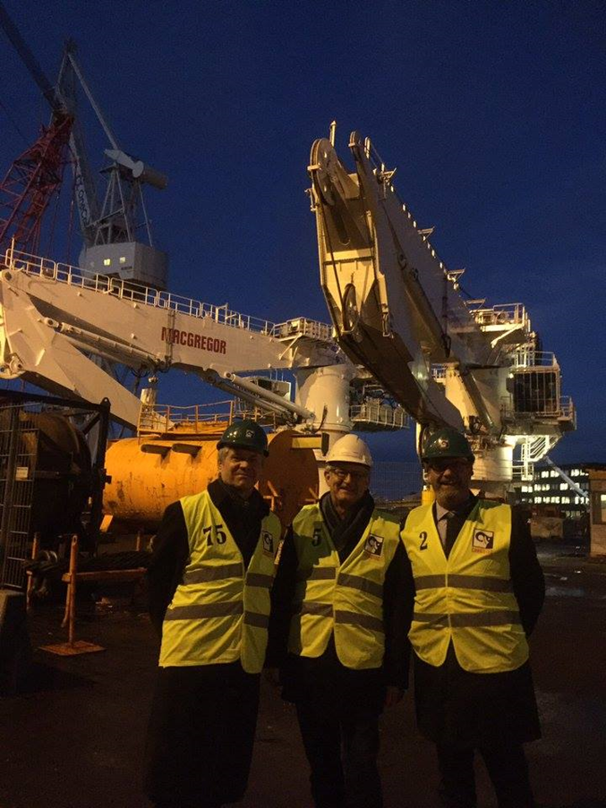
How we can help in Norway
Ambassador opens doors
Conferences and Trade Promotion
Own seminars and network
Communications
Vainu.io Norway, Norge Bygges, etc.
Be in touch but remember to
Utilise services in Finland
Prepare and search info
Do your homework
Secure financial needs

Slide 12
Kiitos – Takk -Thank You!
Jukka Suokas
jukka.suokas@businessfinland.fi
Tel. +47 954 22 131
Embassy of Finland
Thomas Heftyes gate 1
0244 Oslo Norway

